Slide 1
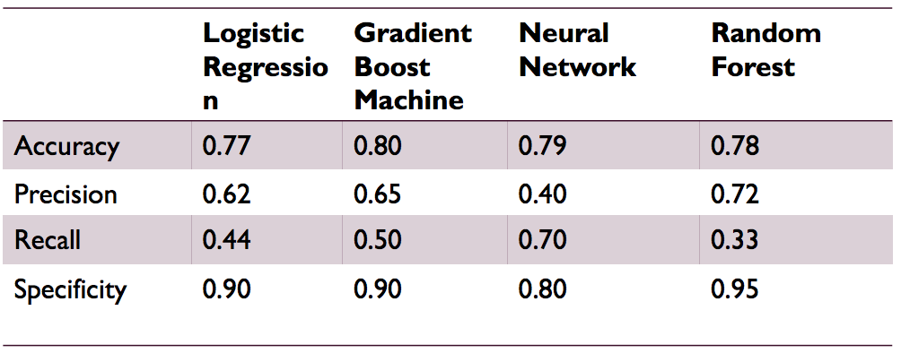
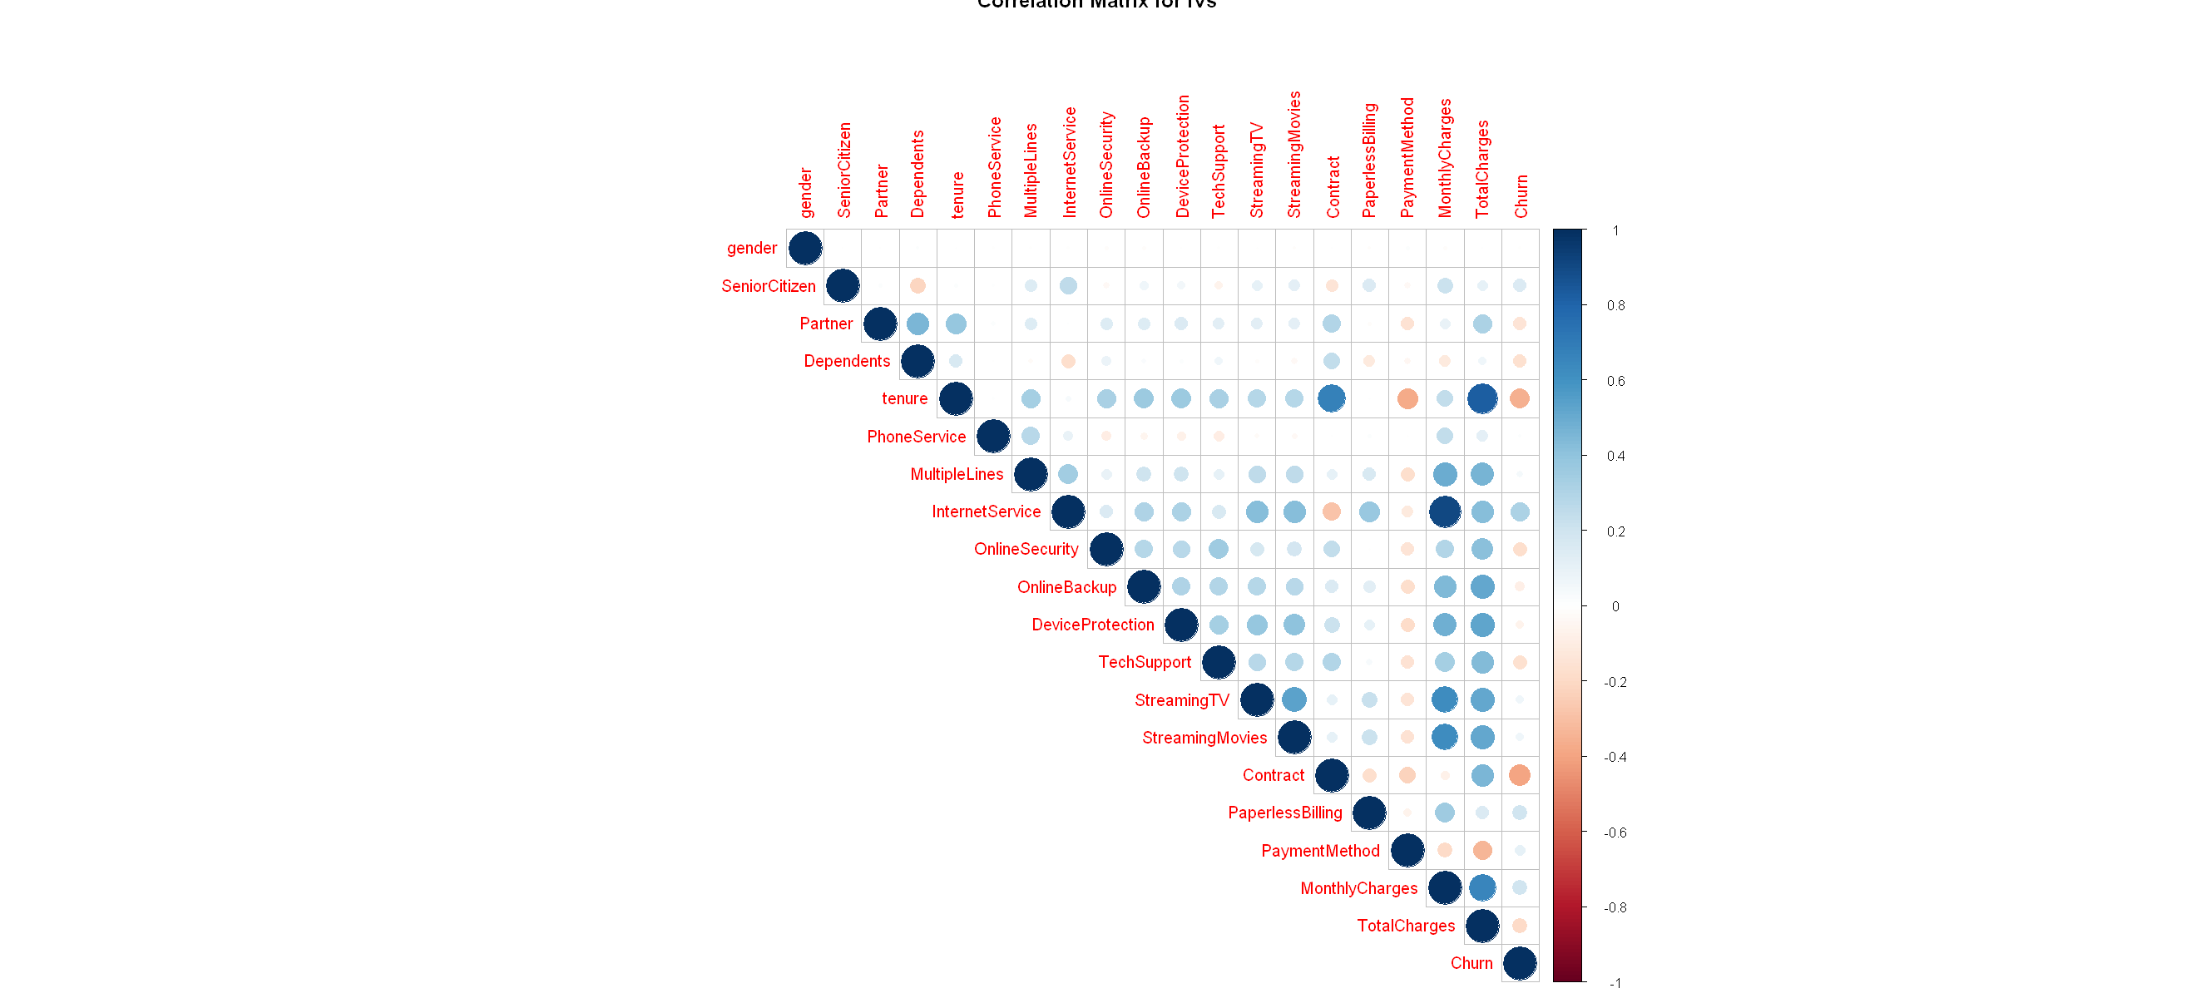
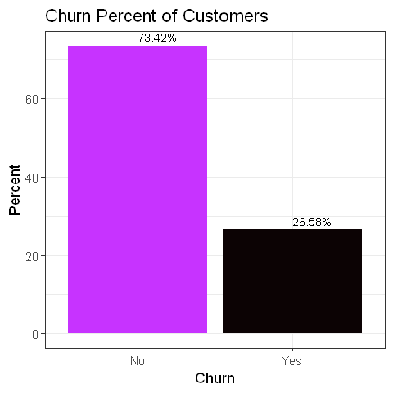

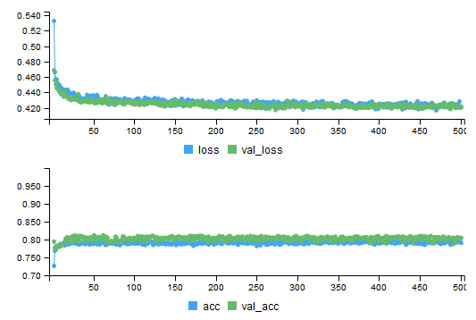
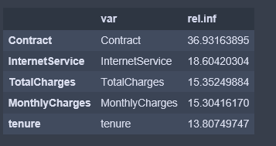
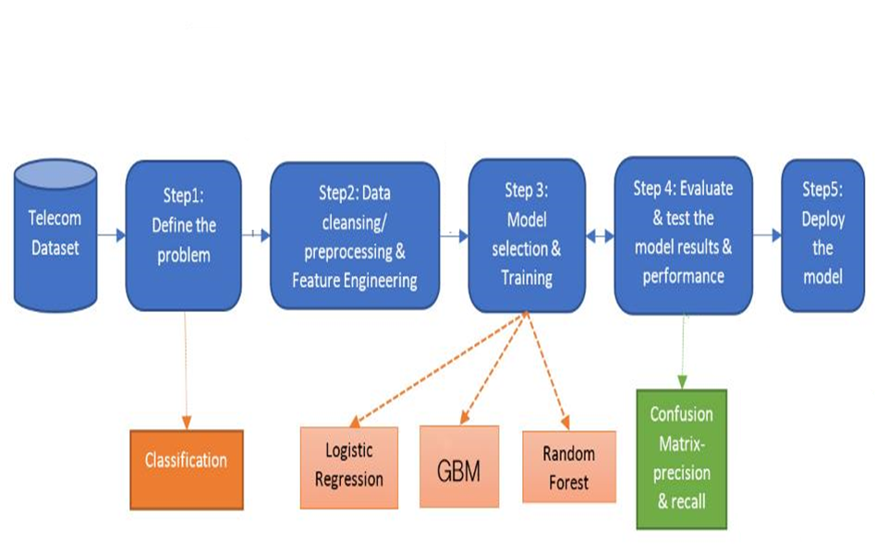
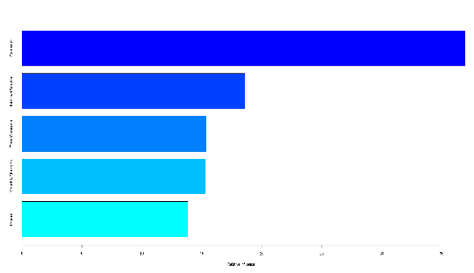
Customer Churn Analysis And prediction
Saad Hsan, Chanpreet Singh
Conclusion
Introduction
Datasets and Limitations
Implementation of Artificial Neural Networks; Forward feed using R Library “Neuralnet,” “nnet” and “MASS”
Clustering of Customer using K-Means algorithm between 2 continuous variables, Monthly Charges and tenure using Library “cluster”
The dataset contains 7022 rows and 21 columns. Features include total Charges, monthly charges, tenure, services availed by customers like Internet Services, Phone Services, type of connections, contract etc.
The dependent variable is Churn, whether the customer leaves the company or not
The dataset was collected from IBM website published on April 2018
Not enough futures to feature to predict churn
Introduction
What is Customer Churn?
Customer ceases his relationship with the company
Why it is important in Telecom Industry?
In Canada there are lot of telecommunication companies like Bell, Fido, Rogers and others are running to get the big share of the market because of competition. Even losing a single customer a big loss for the company.
Challenges:
Accurate prediction of Customers Churn
Finding the Categories involving customers to churn
Objectives
This project discusses about the churn analysis of telecom company customers and relationship between factors contributing the customer to leave the company as these factors contributing the big loss in the business.
In this project, following are the primary objectives
Finding the factors contributing the customers to Churn
Based on the categories, comparison of different algorithms
Evaluation of existed methods and new methods based on the confusion matrix
Methodology
Resullt
Reference
Acknowledgements
We would like to thank our supervisor Olga Baysal and Elio Velazquez for their valuable guidance and motivation which was essential for the progress of our project.
[1] Manpreet Kaur and Dr. Prerna Mahajan, “Churn Prediction in Telecom Industry Using R,” International Journal of Engineering and Technical Research (IJETR), vol. 3, Issue.5, May. 2015
[2] IBM data analysis on customer support retrieved from https://www.ibm.com/communities/analytics/watson-analytics-blog/guide-to-sample-datasets
Techniques
Existed methods include Logistic regression and Random forest.
We used Artificial Neural Network and Gradient boosting Machines
f(x) = b +xi wi

